Slide 1
BIA 686 PRATICUM IN ANALYTICS
Final Project Presentation

Slide 2
Brand Value Comparison:
BIA 686 - Final Project Presentation – Group 9
Group Members:
Daresh Rishi Puri
Jagan Kumar Galla
Prameela Rani Vakkala Gadda
Sowjanya Sakhamuri
Professor : Christopher Asakiewicz

Slide 3
Contents
Introduction
Problem Background
Research Questions
Answers
Visualizations
Data Analysis
References
Conclusion

Slide 4
INTRODUCTION:
Scope: We have carefully selected a wide variety of sports cars from top manufacturers, like Porsche, Lamborghini, Ferrari, Audi, and McLaren, to highlight in our dataset.
Entries: The dataset encompasses 1007 entries, each representing a unique sports car model.
Features: We have comprehensive data on eight important attributes for every car:
Car Make and Model: Determining the sports car's brand and particular model.
Year: The automobile's model year.
Engine Size (L): The car's engine's displacement expressed in liters, which shows the engine's size.
Horsepower: An indicator of an automobile's engine power.
The engine's torque, measured in pounds per foot, is a vital component of acceleration.
0–60 MPH Time (seconds): This crucial performance metric measures how long it takes the car to accelerate from zero to sixty kilometers per hour.
Price (in USD): The car's market price expressed in US dollars, which represents its worth and place in the industry.

Slide 5
Problem Background:
Diverse Market: A variety of sports vehicles from top producers, including Porsche, Lamborghini, Ferrari, Audi, and McLaren, are featured in the dataset. With more than 1007 entries, each describing a distinct model, the dataset captures the richness and diversity of the sports car scene.
Extensive Information: The dataset's extensive coverage, encompassing crucial characteristics such as vehicle model and year, engine displacement, power and torque, acceleration from zero to sixty miles per hour, and cost, offers a strong basis for leveraging data-driven insights to tackle diverse market issues.
Personalization Gap: The market for systems that recommend cars based on individual preferences is severely lacking. Prospective purchasers encounter difficulties in locating the ideal car that fits their unique requirements, tastes, and financial constraints. Personalized recommendation systems can be developed using the dataset to close this gap.
Analysis of Investments: Sports automobiles are frequently regarded as wise purchases that will increase in value over time. There aren't many readily available resources on the market that evaluate the investment potential of sports cars based on performance measures, rarity, and past price appreciation. There is a chance to use the dataset to develop an investing analysis tool that helps investors and fans.
Innovation and Features: Although the sports car business is at the forefront of automotive innovation, there is still room for improvement in terms of new features that can improve the driving experience. By utilizing the dataset, a thorough market gap analysis can pinpoint unmet customer wants and spur innovation in the next generation of sports cars.

Slide 6
Research Questions:
How do average prices vary among different sports car brands, and which brands are positioned as premium versus budget-friendly?
The dataset contains information about several sports automobiles, such as make, model, year, engine size, horsepower, torque, acceleration (0-60 MPH time), and price in USD. Let's look at the typical pricing of different car models to see which are classified as premium versus budget-friendly in the sports car category.
I'll determine the average price for each automobile brand and then categorize them based on that average. ​​
Based on the dataset's average costs, here's how the automobile brands are priced within the sports car category:
Budget-Friendly Brands
Mazda: Average price of approximately $26,830
Subaru: Average price of approximately $38,170
Toyota: Average price of approximately $43,072
Nissan: Average price of approximately $50,752
Mid-Range Brands
Chevrolet: Average price of approximately $55,247
Dodge: Average price of approximately $70,977
BMW: Average price of approximately $80,134
Audi: Average price of approximately $93,875

Slide 7
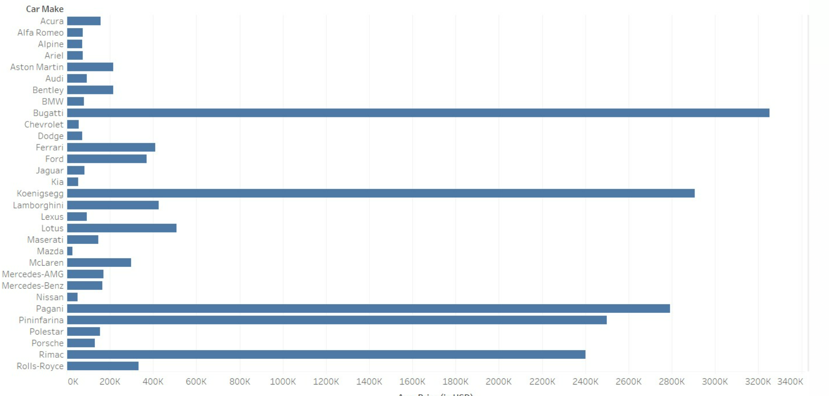
Premium Brands
Porsche: Average price of approximately $129,478
Mercedes-Benz: Average price of approximately $164,661
Aston Martin: Average price of approximately $215,079
McLaren: Average price of approximately $297,808
Ultra-Premium / Luxury Brands
Ferrari: Average price of approximately $410,099
Lamborghini: Average price of approximately $425,947
Rolls-Royce: Average price of approximately $333,235
Hypercar Brands
Bugatti: Average price of approximately $3,251,957
Koenigsegg: Average price of approximately $2,906,667
Pagani: Average price of approximately $2,791,667

Slide 8
2. What factors contribute to the premium pricing of certain sports car brands over others?
Design and Customization: Unique design elements and extensive customization options can also contribute to the higher costs. Sports cars that offer bespoke features or extensive personalization tend to be more expensive.
Exclusivity and Production Volume: Lower production levels foster a perception of exclusivity, which can result in higher prices. Limited edition models or cars created to order might be much more expensive due to their scarcity.
Materials and Build Quality: The use of high-quality materials like as carbon fiber, premium leather, and other luxury components raises the cost. These materials not only provide a better appearance and feel, but they also improve performance and comfort.
Marketing and Positioning: Pricing can be influenced by a brand's market position and marketing activities. Brands that position themselves as luxury or high-performance options frequently price their automobiles higher to reflect their brand image.
Brand Prestige and Heritage: Brands having a lengthy history or a reputation for competence in automotive engineering may attract higher costs. A brand's history and renown play an important role in determining its perceived worth.
Technological Innovations: Incorporation of advanced technology, whether for performance enhancement, safety, or entertainment, also contributes to higher costs.
Porsche 911 (2022): Engine Size - 3.0L, Horsepower - 379, Torque - 331 lb-ft, 0-60 MPH - 4 seconds, Price - $101,200.
Lamborghini Huracan (2021): Engine Size - 5.2L, Horsepower - 630, Torque - 443 lb-ft, 0-60 MPH - 2.8 seconds, Price - $274,390.
Ferrari 488 GTB (2022): Engine Size - 3.9L, Horsepower - 661, Torque - 561 lb-ft, 0-60 MPH - 3 seconds, Price - $333,750.
Audi R8 (2022): Engine Size - 5.2L, Horsepower - 562, Torque - 406 lb-ft, 0-60 MPH - 3.2 seconds, Price - $142,700.
McLaren 720S (2021): Engine Size - 4.0L, Horsepower - 710, Torque - 568 lb-ft, 0-60 MPH - 2.7 seconds, Price - $298,000.

Slide 9
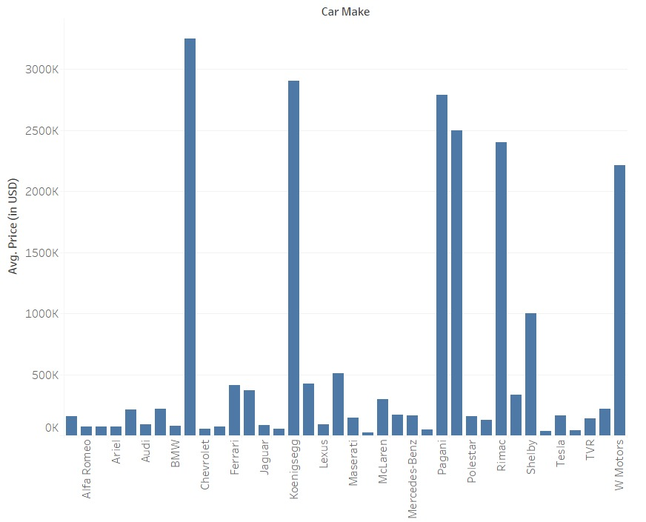
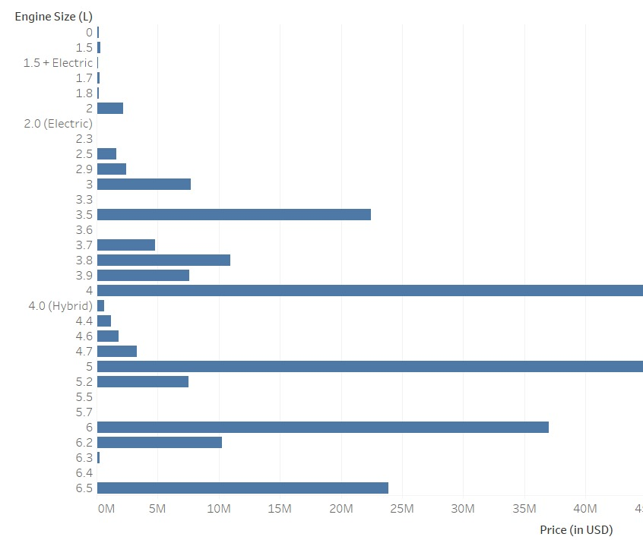

Slide 10
3. How does the brand value reflected in pricing influence consumer choice in the sports car market?
Perceived Quality and Prestige: Higher prices often signal superior quality or exclusivity in consumers' minds. Brands that command higher prices are typically perceived as more prestigious or luxurious. This perception can make them more desirable to consumers who see vehicle purchases not just as practical decisions but as status symbols.
Brand Loyalty and Identity: Consumers may develop a strong loyalty to specific brands due to their history, reputation, or personal identity alignment. For example, brands like Ferrari or Porsche have rich racing heritages that appeal to enthusiasts, influencing their willingness to pay premium prices.
Resale Value: Consumers consider the depreciation rate of a car as part of their purchase decision. Sports cars from brands with strong market recognition tend to hold their value better, which can justify higher upfront costs.
Innovative Features and Performance: Sports car buyers often look for the latest in technology and performance, which can carry a higher price tag. Brands that consistently invest in innovation can justify higher prices because they offer cutting-edge features or superior performance.
Marketing and Branding Strategies: Effective marketing can enhance a brand's perceived value, making consumers more willing to pay a premium. Exclusive experiences, sponsorships, and advertising contribute to building a brand's prestige.

Slide 11
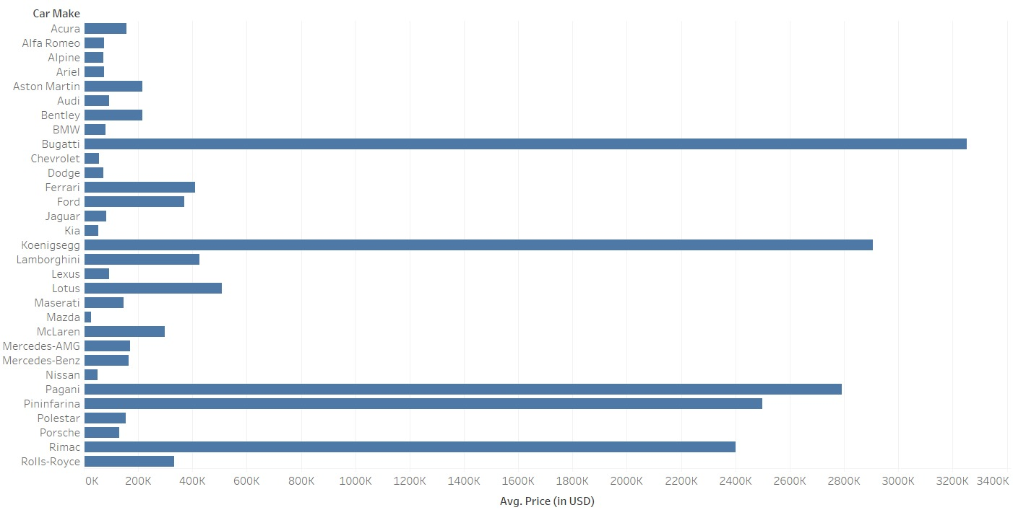

Slide 12
Data Analysis:
Methodology:
Loading Data: Importing the sports car price dataset with Pandas.
Cleaning Data: Converting price and other feature data from strings to numeric types, dealing with non-numeric characters, and potentially missing or malformed data.
Feature Conversion: Ensure that all important features (such as engine size, horsepower, torque, and acceleration time) are in a numerical format that allows for correlation analysis.
Correlation Matrix: Use a heatmap to calculate and visualize correlations between car specs (engine size, horsepower, etc.) and costs. This study helps to determine which specifications are most closely connected with increased prices.
Model Development: Using pandas for data manipulation, matplotlib and seaborn for plotting and visualization, and numpy for numerical operations such as random data creation.
Sales Volume Simulation: When actual sales data is unavailable, a sales volume dataset is simulated for demonstration reasons. This entails creating random data to model how sales volume might fluctuate amongst brands with varying average costs.
Scatter Plot: Visualizing the link between average prices and simulated sales volumes in order to identify potential patterns or trends that may reveal how pricing influences customer behavior.

Slide 13
Analysis Results:
Brands like Bugatti, Rolls-Royce, and perhaps Ferrari seem to have the longest bars, indicating that they are likely the most expensive on average and hence positioned as premium brands.
On the other hand, brands with shorter bars, which might include Kia, Ford, and perhaps Nissan, could be considered more budget-friendly within the sports car category.
Scatter plot likely shows a correlation between sports car prices and a performance metric. If data points trend upward, it suggests that higher prices may be associated with better performance.
A trend where larger engine sizes may correspond with higher sports car prices, indicating engine size as a possible factor in premium car pricing.
A bar chart depicting the pricing distribution of several car manufactures. This graphic would allow us to easily compare different brands' pricing tactics.
A scatter plot depicting the association between price and performance indicator. Such scatter plots can assist us determine whether there is a correlation between the two variables being compared.

Slide 14
Expected Impact:
Manufacturers may adjust their production strategies to focus on features that command higher prices, potentially shifting towards larger engines or enhancing performance if the market shows a willingness to pay for these attributes.
Marketing strategies could be refined to highlight attributes that justify premium pricing, such as superior engine performance or acceleration capabilities, aligning with consumer perceptions of value.
Consumers might use this information to make more informed decisions, balancing their desire for performance with their budget constraints.
Industry Trends could shift as a result of these insights, with premium brands possibly emphasizing their high-performance metrics, while budget-friendly brands might focus on offering competitive performance at a lower cost.
Investment in research and development could be influenced as car companies strive to innovate in areas that add the most value to their offerings, potentially leading to advancements in engine technology and performance enhancements.

Slide 15
Implemented Strategies:
Pricing strategies:
Conduct market segmentation to properly position brands, separating premium from budget-friendly options based on average costs.
Implement dynamic pricing models for premium products that take into account exclusivity, performance, and luxury features.
To appeal to price-sensitive clients, budget-friendly firms should prioritize cost-optimization and value-for-money features.
Premium Pricing Factors:
Premium brands may spend in high-quality materials, cutting-edge technology, and performance engineering to justify higher costs.
Marketing and branding strategies can focus on developing a unique brand image that appeals to high-net-worth individuals.
Incorporate distinctive design elements and limited-edition models to increase the perception of exclusivity and justify premium price.
Brand Value and Consumer Choice:
Use brand heritage and reputation in advertising to increase perceived value and justify higher prices.
Customer service excellence and personalized customization possibilities can be highlighted to increase brand value.
Use social evidence and endorsements to strengthen a brand's status, influencing consumer preference for more expensive sports automobiles.

Slide 16
References:
https://www.kaggle.com/datasets/rkiattisak/sports-car-prices-dataset.
https://www.caranddriver.com/
https://www.reddit.com/r/cars/
https://www.pistonheads.com/

Slide 17
Conclusion:
The Personalized Car Recommendation System demonstrates how data can be used to customize the customer experience and make sure that any enthusiast can quickly and precisely identify the sports car of their dreams.
By presenting sports cars as noteworthy assets with potential for gain, the Sports Car Investment Analysis Tool demystifies the investing environment and offers a fresh viewpoint on car collecting.
Automakers are challenged by the Market Gap Analysis for New Features to innovate beyond what they currently offer. By doing this, it should be possible for upcoming sports vehicle generations to surpass rather than just meet changing consumer expectations.
The initiative analyzes unmet consumer demands and possible areas for product refinement by examining price data, performance indicators, and sports vehicle characteristics. This helps manufacturers create innovations that will appeal to both present and future consumers.
The thorough study conducted provides important insights into the intricacies, trends, and customer preferences of the sports vehicle market, laying the groundwork for focused innovations and marketing tactics.
The exploratory data analysis highlights the need for ongoing innovation and adaptability to shifting consumer needs within the sports vehicle market and provides a foundation for future research and development opportunities.

Slide 18


